Slide 1
Just Culture
Just Culture Work Group

Slide 2
What is Just Culture?
An environment that encourages learning, reporting errors and hazards, designing safe systems, and making safe choices.
“Just Culture focuses on evaluating the behavior and choices made by an individual, not on the outcome of the event” (NC Bd of Nursing).
Notes:
Just Culture aims to produce a culture focused on preventing errors and/or catching errors early before harm is caused. Just Culture welcomes open and honest communication with self reporting of problems/errors, including but not limited to unprofessional behaviors, which could foster poor outcomes. As humans, errors are made but we do have control over our behavior patterns.

Slide 3
Tenets of Just Culture
Humans make mistakes
Creating a culture that is fair and just
Using a common language
Balancing accountability
Notes:
A Just Culture Model acknowledges that humans make mistakes, and these mistakes should be measured and monitored with the goal being error reduction (rather than error concealment) and improved system design. This is not to be confused with a “no blame policy”. Just Culture does not tolerate conscious disregard to patient risks or gross misconduct but rather encourages accountability for reporting a problem, assessing the situation, diagnosing the problem, and creating a plan to avoid that problem again. Just Culture aims to move away from an overly punitive culture and strikes a middle ground between punitive and blame free.

Slide 4
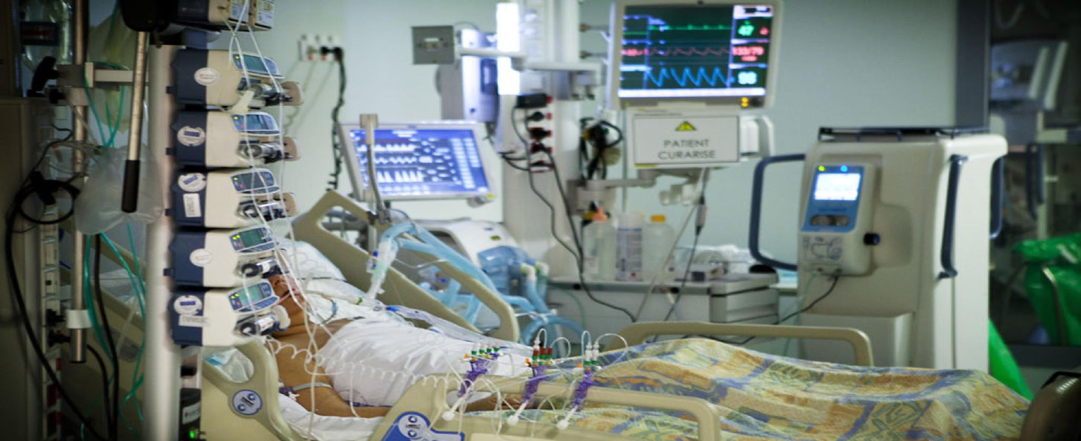
Is there any possibility for error?
Notes:
As you can see in this picture, there are many opportunities for human mistakes to be made.

Slide 5
Questions?
Why did these accidents happen?
What can we do to prevent them from happening again?
How do we judge the people involved?
Notes:
These questions must be evaluated to determine the nature of the error and develop a consequence of action.

Slide 6
The behaviors to be expected when assessing an event
Human Error- inadvertent action; slip, lapse, mistake
At risk behavior- behavior choice that increases risk where risk is not recognized or is mistakenly believed to be justified
Reckless behavior- behavioral choice to consciously disregard a substantial and justifiable risk
Notes:
When an error is made, there are three categories the event can fall under. The first question asked is: was the standard of care met? To further evaluate this, we must assess whether another individual, with the same level of training, could have made the same error? For example, a nurse administers a first dose of amoxicillin prescribed to a pediatric patient for a strep throat infection. The patient has no known allergies. The patient becomes anaphylactic and dies. Was the standard of care met?
At risk behavior involves violating the standard of care without intent to cause harm. For example: a nurse ignores policy and best practice and hurriedly prepares medications for three patients at one time. In doing so, she almost mixes up two patient’s medications. This demonstrates risky behavior and would be reckless if the nurse had not caught herself.
Reckless behavior is a conscious choice to violate the standards of care. For example, a nurse fails to listen to a patient’s apical pulse prior to administering digoxin. The patient’s pulse was 48 bpm. This nurse violated the standards of care and best practice.

Slide 7
Consequences
Human error – console
At risk behavior- coach
Reckless behavior- remedial action or disciplinary action
Notes:
Once the action of the individual is categorized, a consequence can be determined. Human error involves consoling the individual or implementing an improvement plan with the individual. At risk behavior involves coaching the student and/or developing a remedial improvement plan with the student. Reckless behavior involves disciplinary action or remediation.

Slide 8
Why should we put Just Culture into practice?
There is a need to learn from accidents and incidents through safety investigation to take appropriate action to prevent repetitive events.
Notes:
Just Culture provides an opportunity to evaluate errors without bias or judgement, learn from these errors, and provide the safest environment for our patients’.

Slide 9
Thank you

